Slide 1

Comprehensive Data Analysis Project
Insights from Sales, Real Estate, and Customer Churn Datasets

Slide 2

Project Objectives
Sales Analysis: Identifying top products and regional revenue drivers.
House Price Study: Understanding how location and area impact property valuation.
Churn Prediction: Analyzing why customers leave and how to retain them.

Slide 3
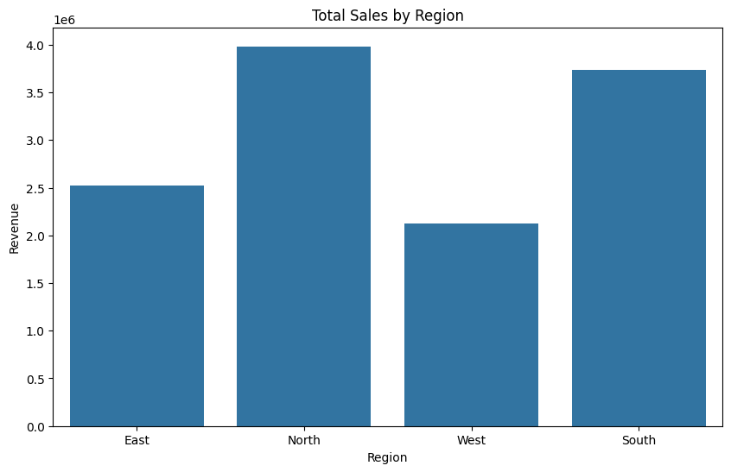
Sales Performance
Top Product: Laptops (Highest quantity sold).
Top Region: North Region leads with $3.98M in total sales.
Insight: High-value items (like Headphones at $49k+) significantly impact revenue spikes.

Slide 4
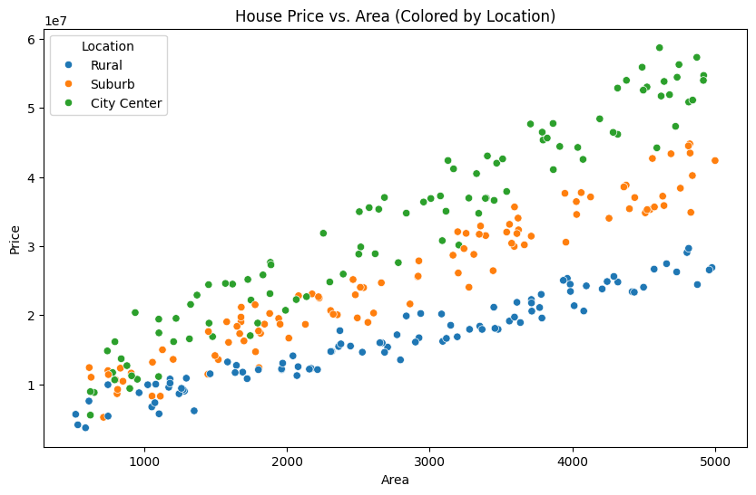
Real Estate Trends
Key Finding: City Center properties are the most expensive (~$33M avg).
Correlation: Strong positive relationship between Area and Price.
Property Type: Apartments are currently yielding higher average prices than Villas in this data.

Slide 5
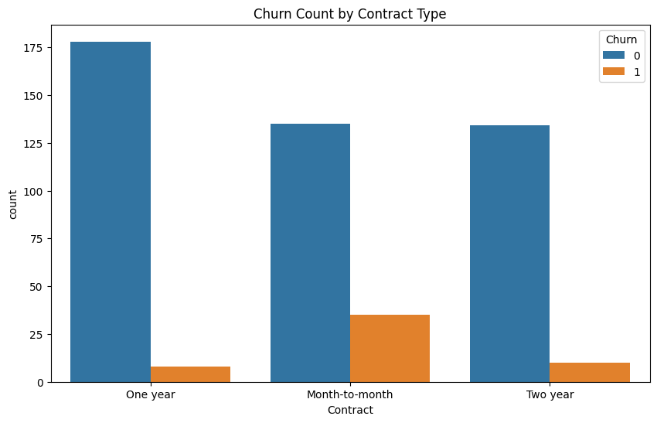
Customer Churn Analysis
Critical Findings: Churn rate is ~10.6%.
The "6-Month" Rule: Most churned customers leave within their first 6 months.
Contract Risk: Month-to-month contracts have the highest churn probability.
Price Factor: Churned customers paid ~$18 more per month on average.

Slide 6
Recommendations & Conclusion
Sales: Scale up marketing in the West region to balance revenue.
Housing: Focus development in City Centers for maximum ROI.
Churn: Introduce "Loyalty Discounts" for customers reaching the 5-month mark to prevent early exit.

Slide 7
Thank You

